Slide 1
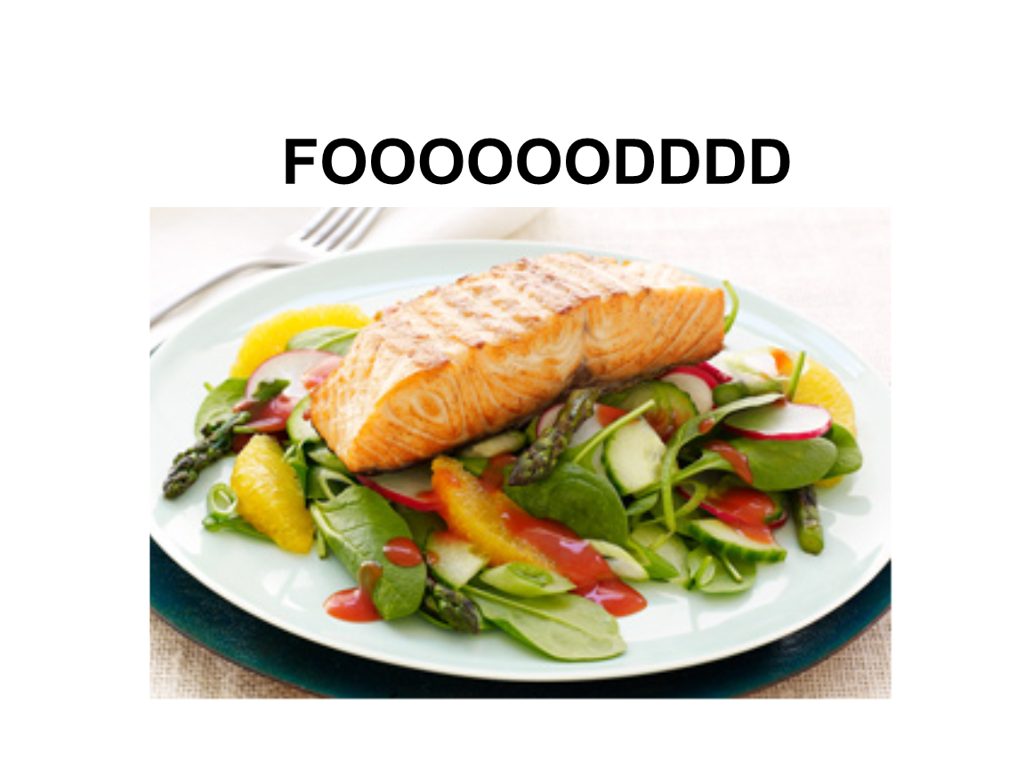
U8 Writing
A food recipe

Slide 2
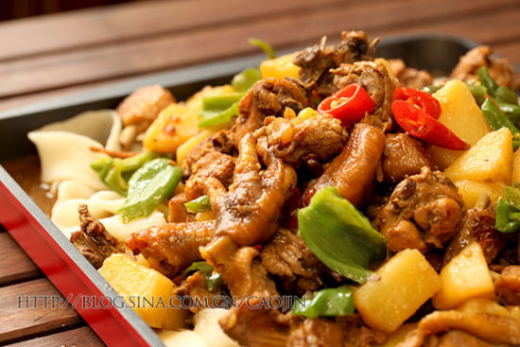
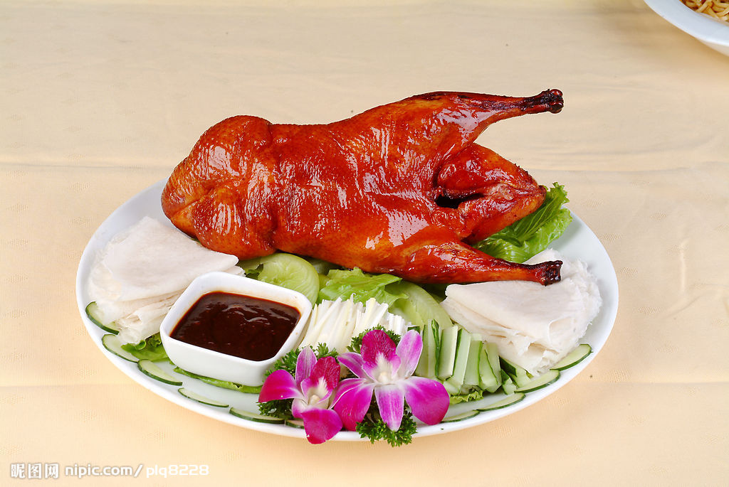
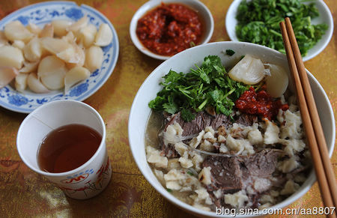
3b
Think of a favorite food in one place.
Beijing Roast Duck
北京烤鸭
Big plate chicken
新疆大盘鸡
Pita Bread Soaked in Lamb Soup
羊肉泡馍

Slide 3
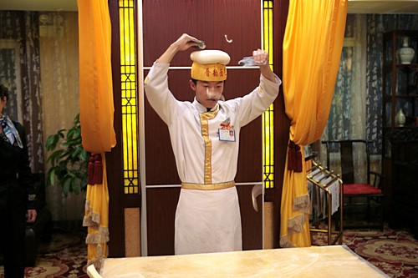
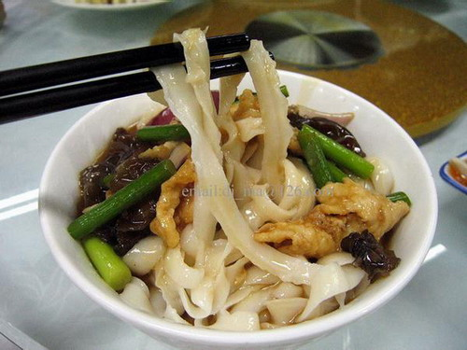
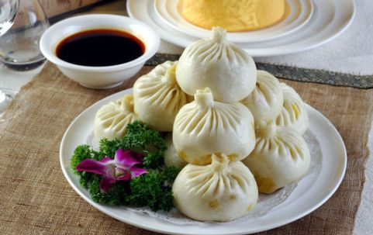
Sliced noodles
山西刀削面
Goubuli buns
天津狗不理包子

Slide 4

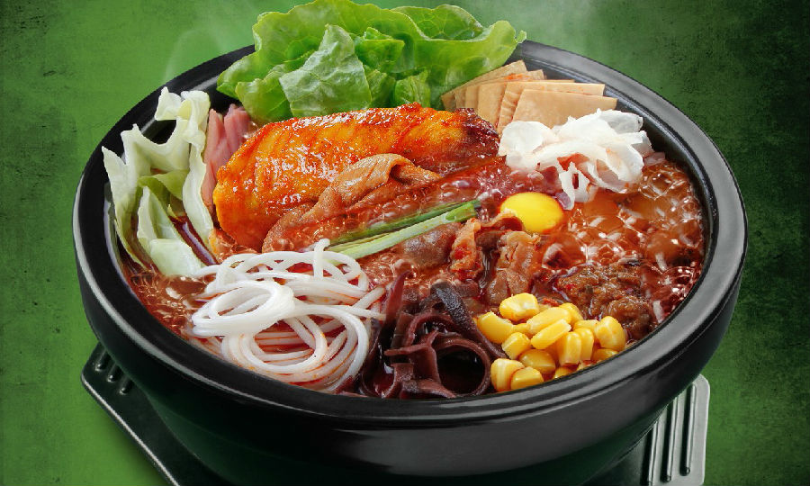
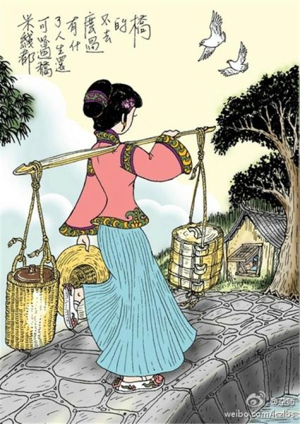
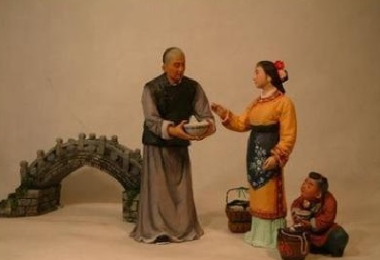
Enjoy a story.

Slide 5
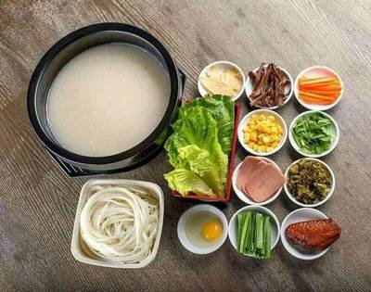
Do you know the ingredients to make Yunnan Rice noodles?
Do you know how to make it?

Slide 6
3a
Read the recipe below and fill in the blanks with the words in the box.
cook next wash finally have enjoy first cut

Slide 7
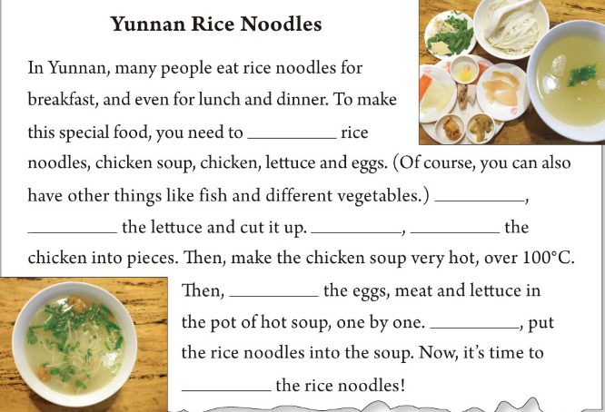
what
ingredients
have
First
wash
Next
cut
how
cook
Finally
enjoy

Slide 8
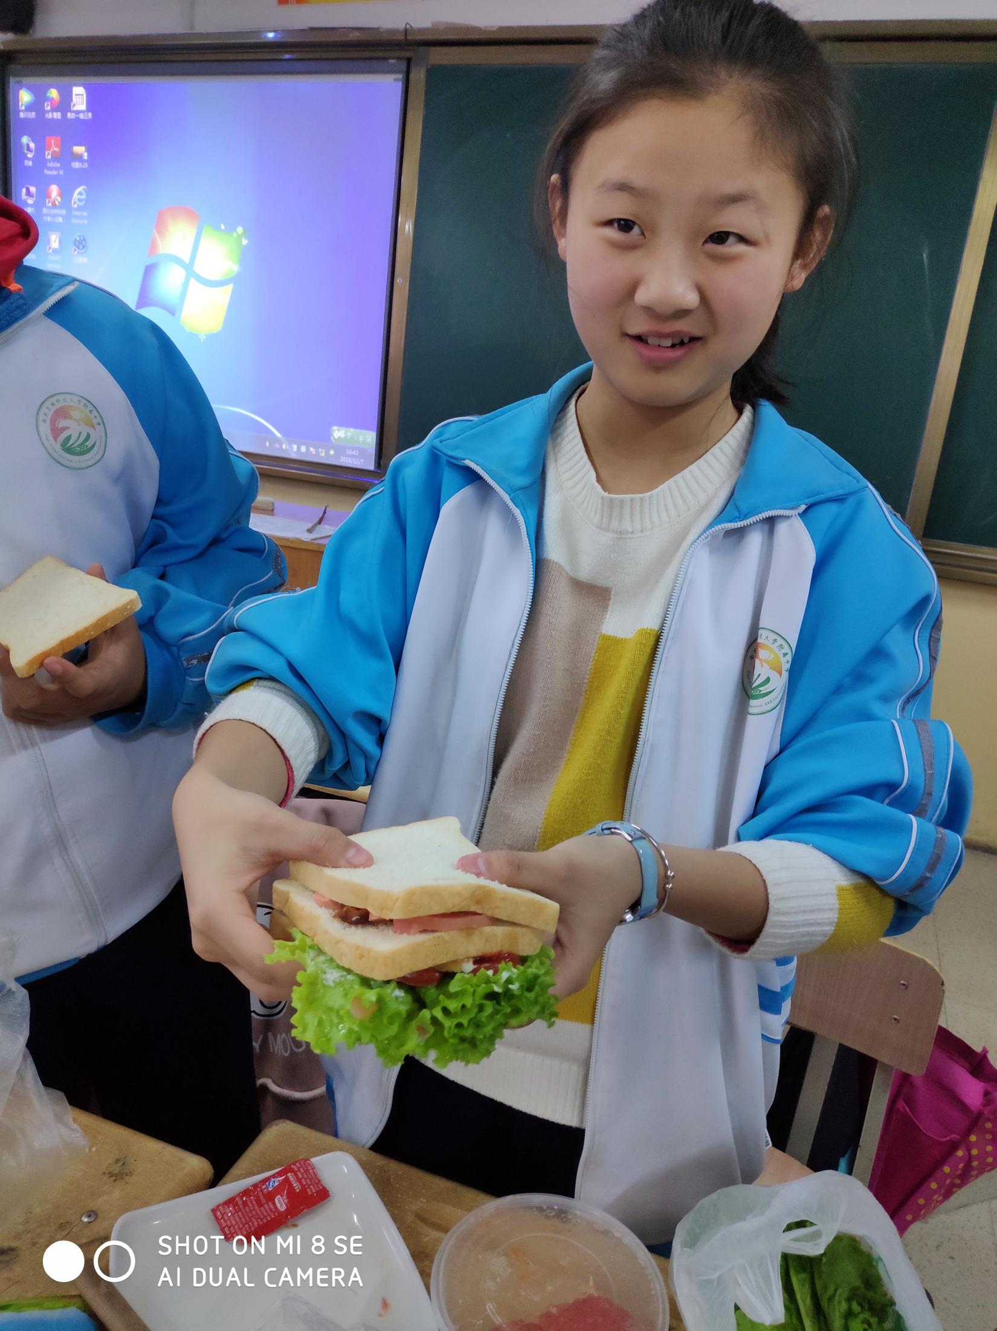
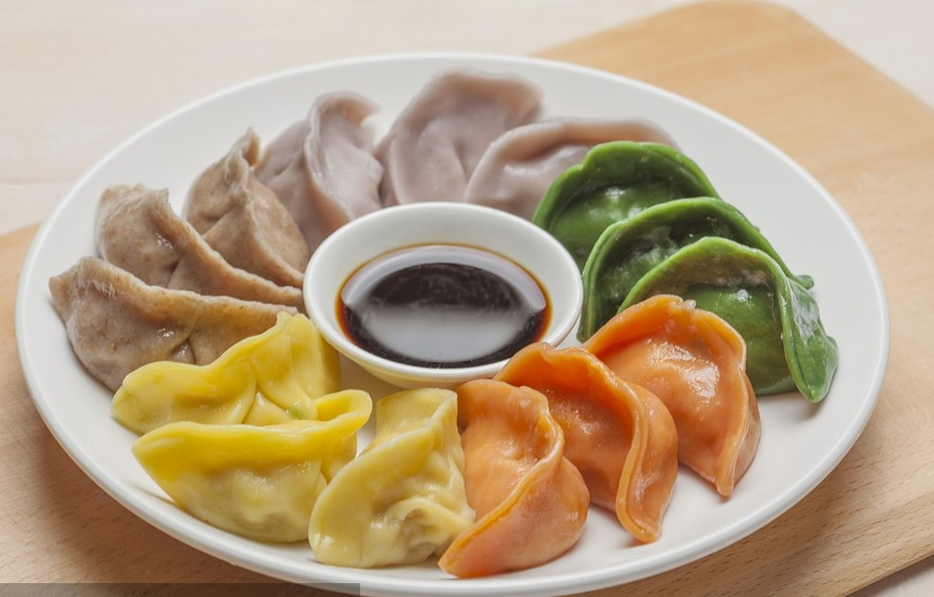
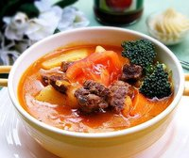
So what's your favourite food? What are the ingredients and how to make them?
Russian soup in Russia
Dumplings that Chinese people eat on Spring New Year's Eve
Sandwiches that are popular around the world

Slide 9
It's your time to have a recipe of your favorite food.
some clues:
What's the food?
What are the ingredients?
How to make it?
some useful expressions:
肉馅 meat stuffing 饺皮jiaoziwrapper 调料 relish
沙拉酱 cream 蒸 steam 煮 boil 搅拌 stir
把韭菜切成小段 cut the leeks into small pieces

Slide 10
第一步：审题： 人称________________ 时态________________
第二步：列提纲
分 段 | 提纲要点 |  | 参考句型
第一部分 | 开篇点题，介绍要分享的美食。 |  | Today I want to introduce a dish called... It’s very good.Now let me show it to you all.
第二部分 | 具体介绍美食制作过程 | 1.First
 |  | 2.Next
 |  | 3.Then
 |  | 4.Finally
第三部分 | 总结全文 |  | You can enjoy it soon.

Slide 11
How to Make a Fruit Salad
Today I want to introduce a dish called fruit salad. It’s very good.Now let me show it to you all.
,We need an apple, a pear, 20 grapes, an orange and two bananas. First, wash the apple, pear and grapes, Next, peel the orange and bananas. Cut the fruit except grapes into small pieces and put them on a plate. Then, add some salad cream, a little sugar and salt. Mix and stir them. Finally, put the grapes around the plate to make the salad look nicer.
Now the fruit salad is ready. You can enjoy it soon.

Slide 12

Thanks for listening.

